Slide 1
Why Has the Value of Cash Increased Over Time?
Thomas W. Bates Arizona State University
Ching-Hung Chang National Taiwan University
Jianxin Daniel Chi UNLV
Presented by Austin Francis

Slide 2
Research Question
How does voluntary information sharing by private borrowers affect lender competition, borrower switching behavior, loan financing costs, and financial constraints?

Slide 3
Prior Literature
An increase in levels of cash can be largely explained by fluctuations in firm characteristics, as well as changes in composition of public firms.
The variation in the marginal value of cash can be attributed to leverage and the relative tax effects of payout decisions. (Faulkender and Wang, 2006)
The value of cash is higher for financially constrained firms. (Denis and Sibilkov, 2010)
Value of cash varies with agency conflicts

Slide 4
Key Findings
The value of corporate cash holdings has increased significantly in recent decades.
This increase is driven by the investment opportunity set and cash-flow volatility, as well as product market competition, credit market risk, within firm diversification.
On average, one dollar of cash is valued at $0.61 in the 1980s, $1.04 in the 1990s, and $1.12 in the 2000s

Slide 5
Data Description
CRSP / Compustat merged database for the years 1980-2009
Excluding financial firms, utilities.
Final sample : 12,845 unique firms and 108,357 firm-year observations

Slide 6
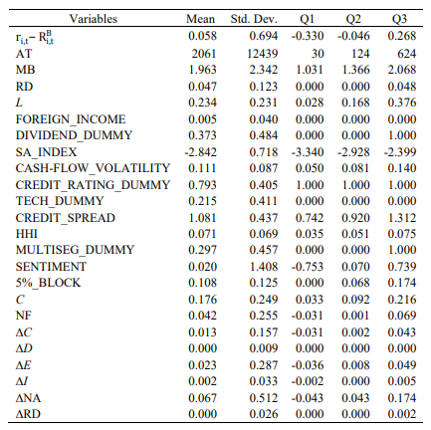
Table 1 – Summary Statistics

Slide 7
Table 1 Takeaways
Notes:
Higher spreads (343 bps for disclosers vs. 282 bps for non-disclosers).
Larger loan amounts ($146 million for disclosers vs. $106 million for non-disclosers).
Longer maturity (68 months for disclosers vs. 49 months for non-disclosers).

Slide 8
Marginal Value of Cash
Methodology described in Faulkender and Wang (2006)
Compute firm’s excess equity return as its nominal return during a fiscal year, minus the benchmark portfolio return estimated using the Fama-French (1993) 25 size and book-to-market portfolios.
Notes:
Disclose = dummy variable
X = loan controls from loan agreement
W = borrower fixed effects
U = lender fixed effects
V = year fixed effects

Slide 9

Marginal Value of Cash
Notes:
This is an econometric model estimating the excess return (ri,t−Ri,tBr_{i,t} - R^B_{i,t}ri,t​−Ri,tB​) of a firm at time ttt, which is the return of the firm minus the benchmark return (Ri,tBR^B_{i,t}Ri,tB​). The model regresses the excess return on several explanatory variables that reflect changes in the firm’s characteristics relative to its market value from the previous period. Here's a breakdown of the equation:
Variables in the Model:
ΔCi,t\Delta C_{i,t}ΔCi,t​: Change in cash.
ΔEi,t\Delta E_{i,t}ΔEi,t​: Change in earnings.
ΔNAi,t\Delta NA_{i,t}ΔNAi,t​: Change in net assets.
ΔRDi,t\Delta RD_{i,t}ΔRDi,t​: Change in research and development (R&D) expenses.
ΔIi,t\Delta I_{i,t}ΔIi,t​: Change in interest expense.
ΔDi,t\Delta D_{i,t}ΔDi,t​: Change in dividends.
All the variables listed above are scaled by the firm's market value at time t−1t-1t−1 (i.e., Mi,t−1M_{i,t-1}Mi,t−1​).
Additional terms:
Ci,t−1Mi,t−1\frac{C_{i,t-1}}{M_{i,t-1}}Mi,t−1​Ci,t−1​​: Lagged cash as a percentage of market value.
Li,t−1Mi,t−1\frac{L_{i,t-1}}{M_{i,t-1}}Mi,t−1​Li,t−1​​: Lagged leverage (debt relative to market value).
NFi,tMi,t−1\frac{NF_{i,t}}{M_{i,t-1}}Mi,t−1​NFi,t​​: Net financing activities (new debt or equity issues) relative to market value.
Coefficients (γ1,γ2,...,γ9\gamma_1, \gamma_2, ..., \gamma_9γ1​,γ2​,...,γ9​):
Each of these represents the estimated impact of the respective firm characteristic on the excess return. For example:
γ1\gamma_1γ1​ captures the effect of changes in cash (ΔCi,t\Delta C_{i,t}ΔCi,t​) on the firm’s excess return.
γ7\gamma_7γ7​ represents the impact of lagged cash holdings on the firm's excess return.
Error term (ϵi,t\epsilon_{i,t}ϵi,t​):
This captures any unexplained variation in the firm’s excess return that is not accounted for by the included variables.
Simplified Explanation:
This model tries to explain how different changes in a firm's financial characteristics (like cash, earnings, and dividends) influence how its stock performs compared to a benchmark return. Each term in the equation looks at how these changes, adjusted by the firm's size (market value), impact stock performance.

Slide 10
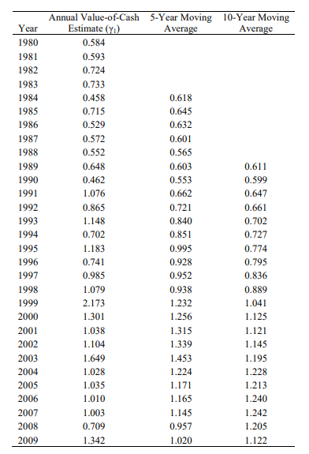
Table 2 - Value of Cash: Annual Estimates and 5-year and 10-year Moving Averages
Notes:
Notice how the Value-of-Cash estimates are rising, regardless of the window length. If you exclude 1999, the correlation is even higher to .64

Slide 11
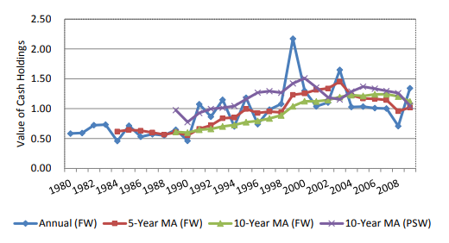

Slide 12
Table 2 Takeaways
Value of cash has been rising over the years
Marginal value of each dollar increased from $0.61 in the 80s to $1.12 in the 200s

Slide 13
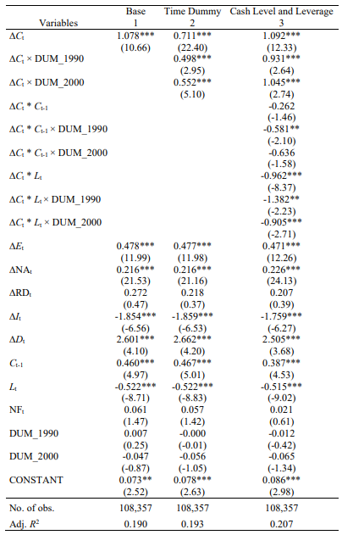
Table 3 -Baseline Regressions: The Increase in the Value of Cash Over Time
Notes:
Model 1 excludes decade indicator variables.
Model 2 has decade indicators for the 90s and 2000s.
The estimates of 90s / 2000s are compared to the baseline of 1980. So you can see how they are increasing as the decades progress Model 3: controls for cash and leverage effects over time.

Slide 14
Table 3 Takeaways
Results highlight a consistent rise in the value of cash over time
Negative impact of cash and leverage over time

Slide 15
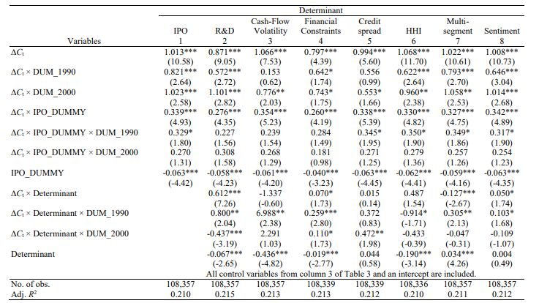
Table 4 - The Impact of Individual Determinants

Slide 16
Table 4 Takeaways
Marginal value of cash is higher for firms in successively later IPO cohorts ($0.329 higher in 1990).
Investment opportunities (as indicated by R&D expenditure) significantly contribute to the value of cash
Firms facing greater financial constraints show a higher value of cash
Firms facing more competition (HHI Index) are associated with higher marginal values of cash

Slide 17
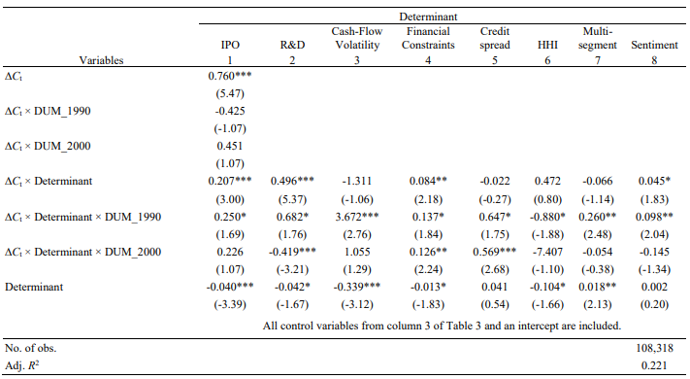
Table 4 - The Impact of All Determinants Simultaneously

Slide 18
Table 4 Takeaways
The statistical insignificance of the decade dummies (∆Ct × DUM_1990 and ∆Ct × DUM_2000) suggests that the variations in cash value over time are well captured by the included economic determinants, rather than by the passage of time alone.
Initially, multi-segment firms (diversification) had a lower value of cash in the 1980s. This relationship fades in significance when considering all factors in Panel B

Slide 19
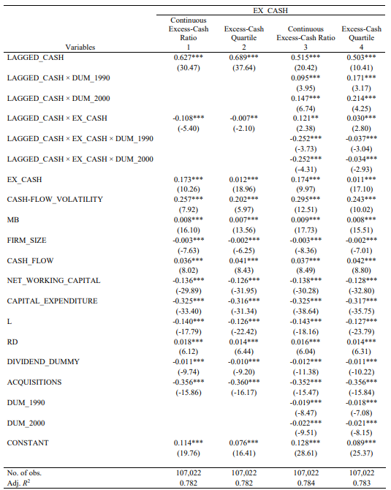
Table 5 – Panel A: SOA Regressions
Notes:
This implies that the SOA if faster for higher levels of excess cash. The key finding is that the interaction term between lagged cash and excess cash is negative, indicating that firms with higher levels of excess cash adjust more quickly toward their optimal cash holdings. This implies that firms with surplus cash can more easily adjust by paying out or investing excess cash, whereas firms with cash deficits face greater frictions.

Slide 20
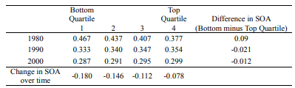
Table 5 – Panel B: The SOA for Quartiles of Excess Cash Over Time

Slide 21
Table 5 Takeaways
Firms with higher cash levels have higher SOA, reflecting lower friction in cash reduction
SOA has generally decreased over time
Top quartile of excess cash holders have unique differences from 80s to 2000s

Slide 22
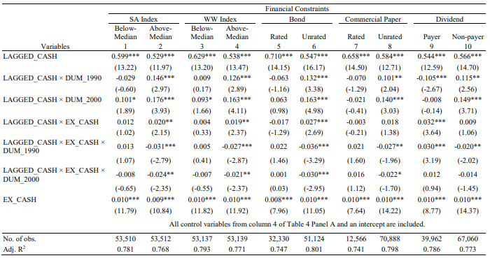
Table 6 – Financial Constraints and the SOA in Cash Holdings Over Time

Slide 23
Table 6 Takeaways
Financially constrained firms consistently show a slower SOA than unconstrained firms across all proxies
Firms with bond ratings or those not paying dividends exhibit higher SOA
The results suggest that firms facing higher financial constraints struggle more to adjust their cash holdings, reflecting increased external financing costs and limited access to capital.

Slide 24
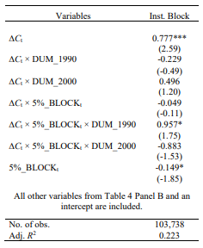
Table 7 – The Effect of Block Holdings on the Value of Cash Over Time
Notes:
Book leverage.

Slide 25
Table 7 Takeaways
Presence of block holders is linked to a significant impact on the value of cash over time
Firms with higher ownership concentration tend to place more value on cash holdings

Slide 26
Conclusion
There has been an increased value of cash over time
This increase is driven by both macroeconomic (credit spreads, and increased competition) and firm specific drivers
SOA has generally decreased over time, likely due to market frictions

